Slide 1
EE209AS Course Project: Home Occupancy Detection Via Encrypted WiFi Traffic Sniffing
Cong(Colin) Jin
ZhuoQi(George) Li
University of California, Los Angeles

Slide 2
Overview
Introduction
Proposed Method
Implementation
Result
Future Work

Slide 3
Introduction -- WiFi (802.11) Traffic Packets
Smart Devices collect & exchange datas with network constantly
Smart Phones, Laptop, IoT devices
Data usage
Need to perform algorithm computation on cloud
Social Media Updates
Streaming
Security issues
Objective: Room Occupancy Detection
Notes:
Focus on encrypted 802.11 traffic

Slide 4
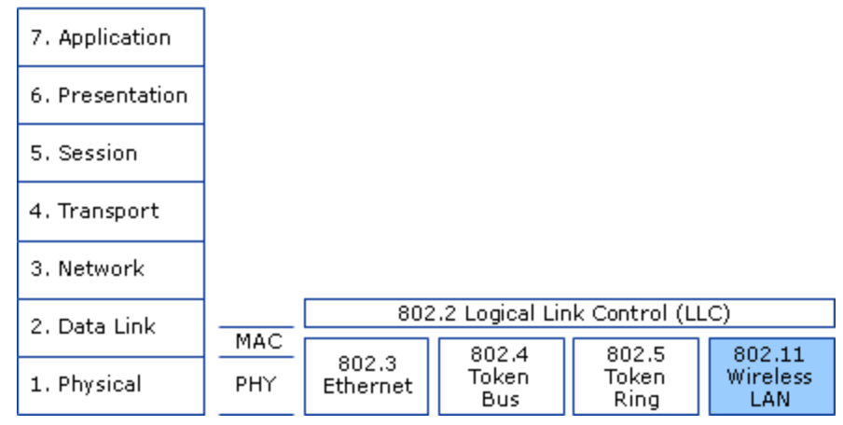
Introduction -- 802.11 & OSI model

Slide 5
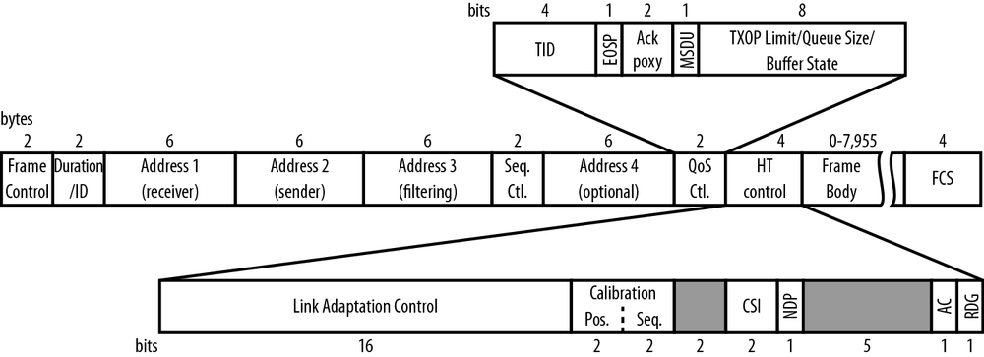
Introduction -- Information Retrieval From Encrypted Network Traffic
Payload is encrypted (WPA2 protected)
802.11 frame is in plain text
Destination/Source
Control/management information
Packet Size
Time stamp
Notes:
Upper-layer payload are contained in the frame body and are encrypted

Slide 6
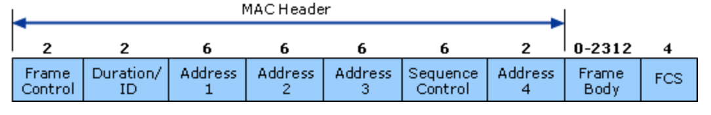
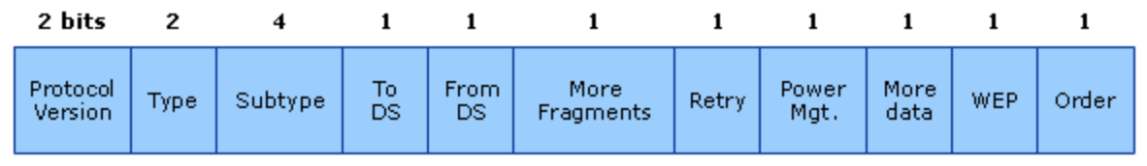
Introduction -- 802.11 MAC Frame
MAC header
Frame Body
Frame Check Sequence(FCK)
802.11 Frame types
Data
Control
Management

Slide 7
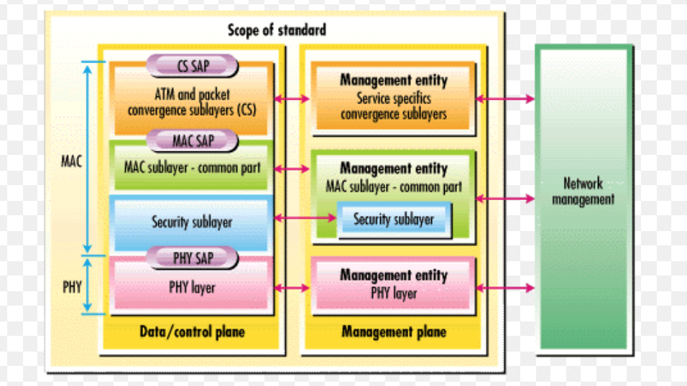
Introduction -- Mac Layer Management Entity (MLME) Frames
Fixed parameters
Vendor-specific tagged parameters

Slide 8
Mac Layer Management Entity(MLME) Frames
Probe Frames
Sent by clients searching for Access Point(AP)
Indicate capabilities of clients (supporting rates, authentication caps etc.)
Association Frames
Sent by clients to be added to the network by AP
Also include client capability
Deauthentication Frames
Clients and Ap can send this frame when all communication is terminated
Disconnect from the WiFi network

Slide 9
Proposed Method I - Traffic Pattern Classification
Motivation
Deep Packet: A Novel Approach For Encrypted Traffic Classification Using Deep Learning
Traffic Pattern Analysis
Traffic collection/filtering
Feature selection/extraction
K-means clustering
Support Vector Machine(SVM)
CNN
Notes:
CNN ---> Kmeans why?
Unsupervised machine learning model
Unknown traffic pattern, unknown devices -> cannot train model

Slide 10
Proposed Method I - Traffic Pattern Classification
Why fail?
In ability to capture all data packets (no Greenfield cap)
Input Feature Dependency
Network Activity Insufficient to infer house occupancy
Other Approach?
Notes:
Inability to capture all data packets Contrary to what we expected, wireless sniffing adapter is actually unable to capture all data packets directed from or to a ceratin device. This is because 802.11n has a special facility called "Greenfield" or "HT" (High throughput) mode that allows data to be transmitted between AP and device with ultra-high speed. We found this special facility is widely apodted in smart devices nowadays and data are transfering in between AP (router) and smart device such as cellphones with a speed higher than what our sniffing device could handle. Therefore, the data packets we captured only makes a very small fraction of total data transfer and most of data traffic were actually unobserved. We were only able to capture data packets that are not transferred via HT mode such as the three-way handshake process packets. Once connection is established, data will be transferred with a much higher rate which our adpater could not handle. Not to mentioned our adpator is reside in a rather noisy environment with in-the-air traffic from more than 20 devices at the same floor of my apartment building. This had been proved in our experiment - no obvious difference in the number of data packets between a idle and a highly active device.
Feature Dependency of the Unsupervised Clustering Model Another major cause resides in features extracted from captured traffic. There are too much redundancy/dependency between features input to the machine learning model and thus leading to inaccuracy. For example, the feature "number of active device in network" has high dependency with the other feature "number of data packets". To be honest, there are very few features we could extracte from encrypted wifi traffic. In the sense that we use unsupervised models, there is no way to evaluate the feature importance and adjust weights accordingly. Furthermore, we can barely understand the metrics behind the clustering results. For example, although we expect the output two cluster representing time periods where people are at home or not, the actual underlying relationship between these two cluster could however indictate when is the target watching movies on laptop or not.

Slide 11
Proposed Method II - Smartphone Fingerprinting
SmartPhone Usage Statistics
60% American Adults own smartphones with Wifi capability
90% of American adults always carry smartphone with them
SmartPhone usage & House Occupancy
Smartphones of Occupants connect with house AP automatically
Occupants take cellphone with them when they leave the house
Occupants do not turn off their cellphones at night and so remain in the network

Slide 12
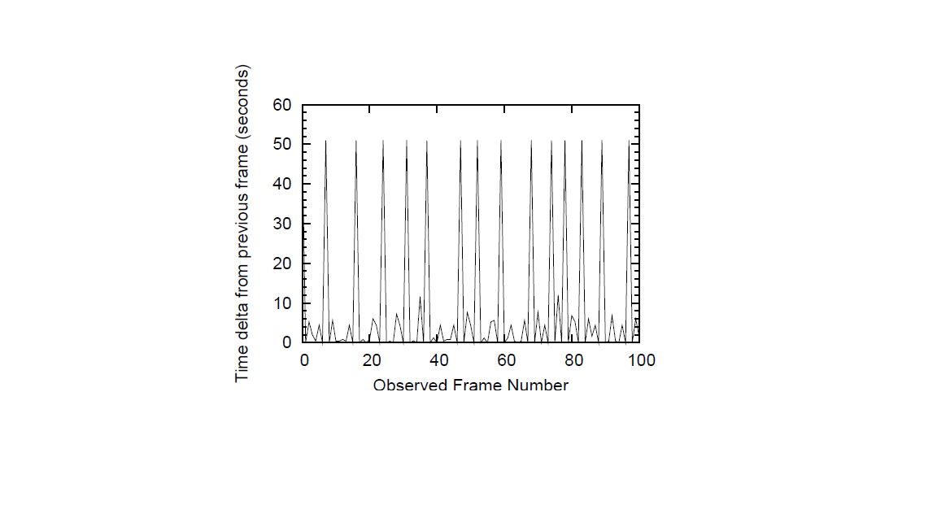
Proposed Method II - Smartphone Fingerprinting
Active Scanning
Identifying unique devices through wireless fingerprinting
Probe request timing analysis
Mac address randomization
A Study of MAC Address Randomization in Mobile Devices and When it Fails

Slide 13
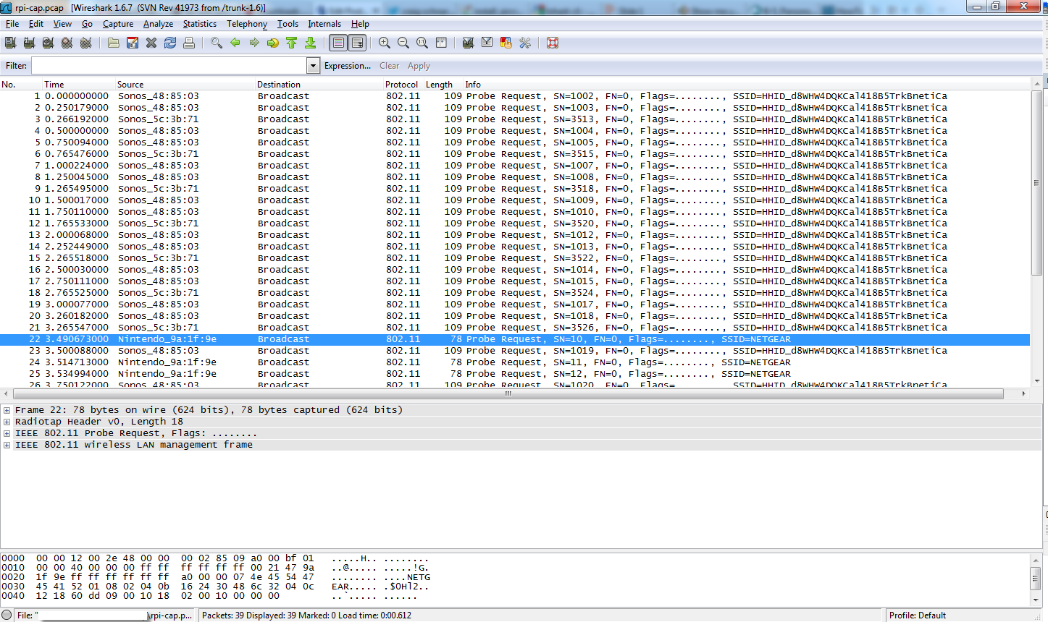
Proposed Method II - Smartphone Fingerprinting

Slide 14
Proposed Method II - Smartphone Fingerprinting
Wifi signatures from MLME frames Tagged parameters
Passive Taxonomy of Wifi Clients using MLME Frame Contents
Generated from 802.11 Probe & Assoc request frames from traffic
Distinctiveness of WiFi Signature
Wifi chip specific
Device driver specific
WPA supplicant specific
PCB layout specific

Slide 15
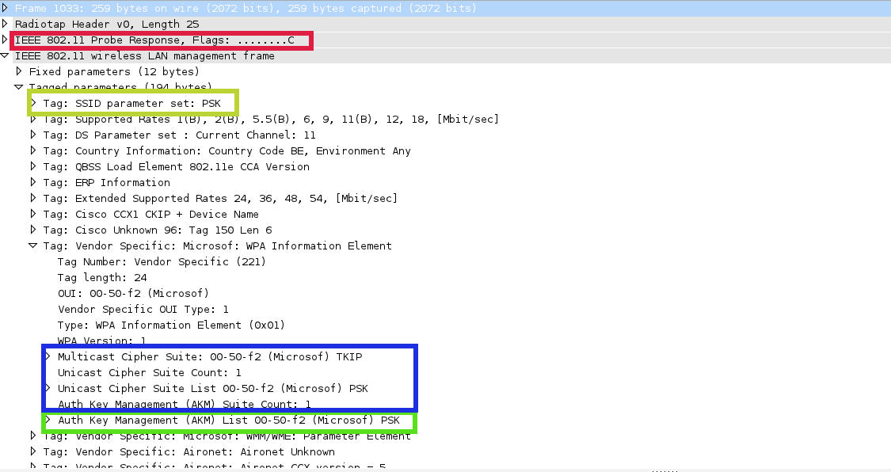
Proposed Method II - Device Fingerprinting

Slide 16
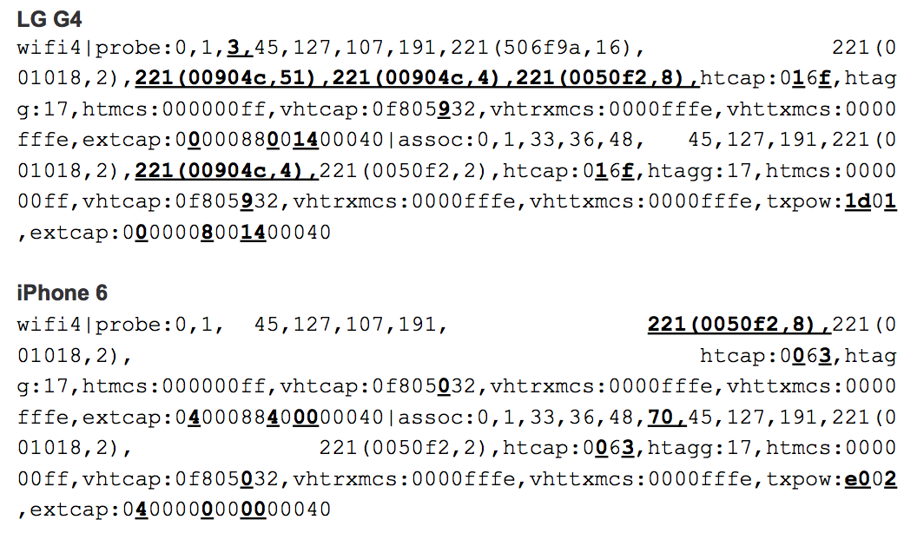
Proposed Method II - Device Fingerprinting

Slide 17
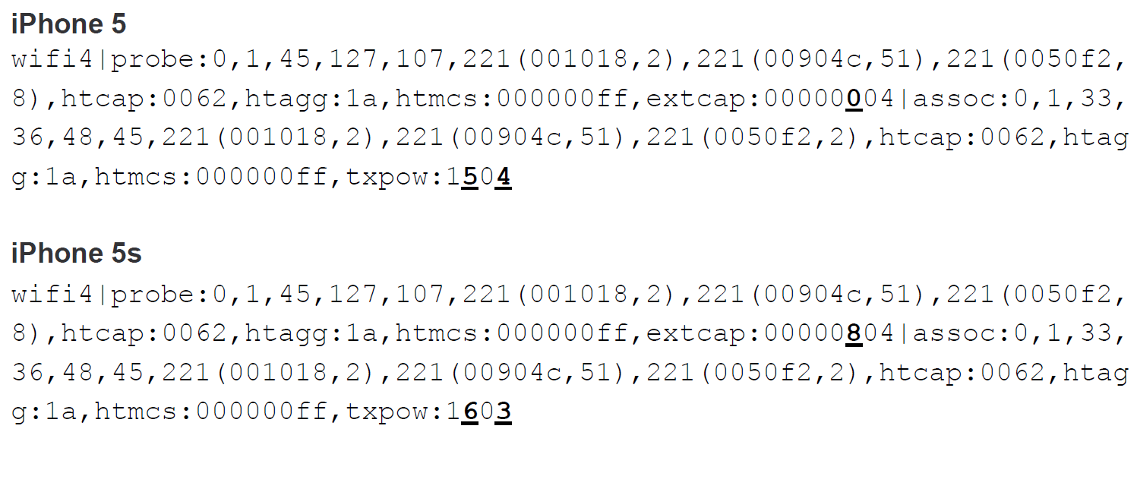
Proposed Method II - Device Fingerprinting

Slide 18
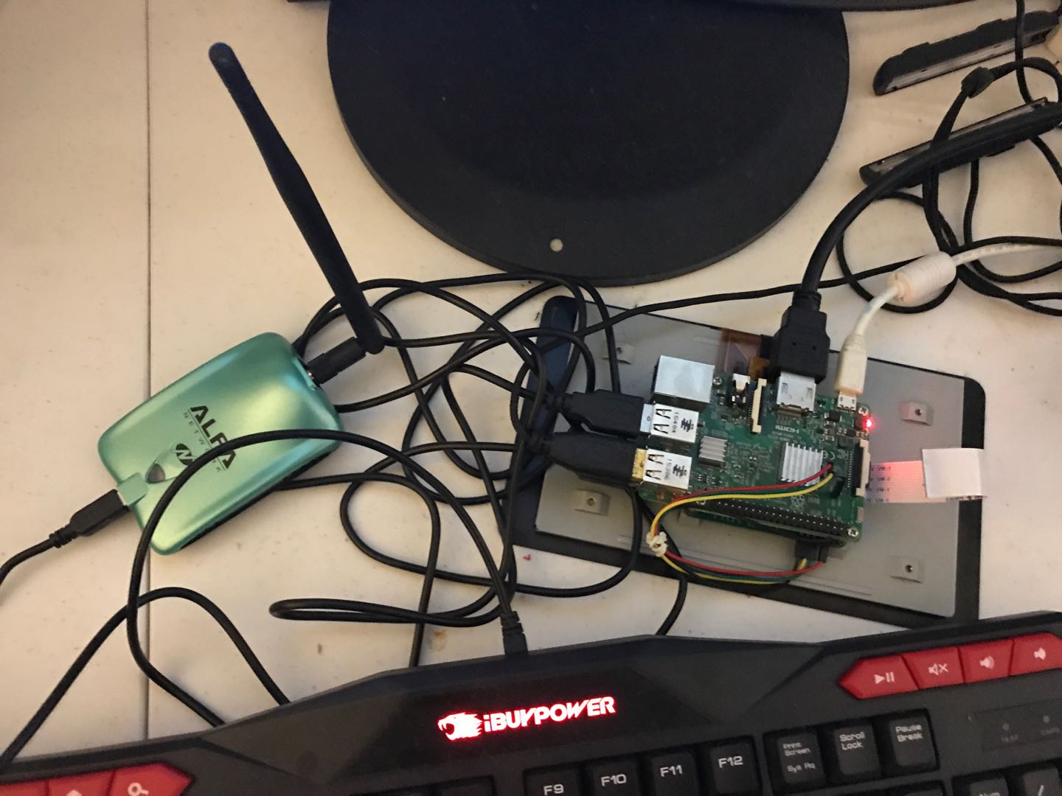
Implementation - Hardware Configuration
Rpi + Wifi Adaptor with monitor mode and packets injection capability
Monitor mode
Packet Injection

Slide 19

Implementation - Software Support
Operating System
Kali Linux
Packet Dump & Inspection
Wireshark
Tcpdump
Packet Injection and AP scanning
airodump-ng
aireplay-ng
Project development
Pycharm
Git

Slide 20
Implementation - Overview
Repeat this step periodically
Monitor Mode Setup
Scan for nearby AP
Active Phase
Passive Phase
Occupancy Report
Device Log

Slide 21
Implementation - Setup
Monitor mode setup
Scan for nearby AP
Airodump-ng
Select target using SNR strength
Record AP mac address and listening channel

Slide 22
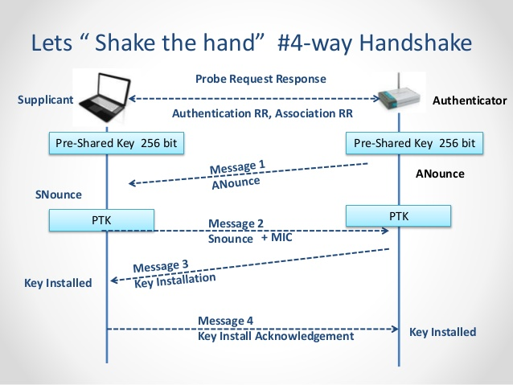
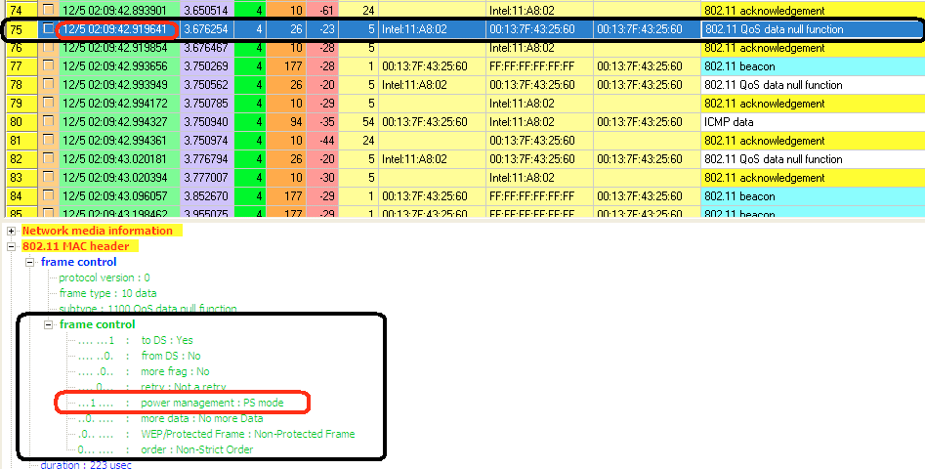
Implementation - Active Phase
What happens upon connection
Deauthentication Attack
Scan for devices - Null data frames

Slide 23
Implementation - Active Phase
Build wifi signature
Identify device
Signature hamming distance
Find match in database
# first Perform device scanning
device_list = device_tracking(Ap_addr, channel, duration='180')
# for each device, launch deauth attack and capture 4-way handshake moment to build wifi signature
for dev in device_list:
deauth(mon_card, target=dev, AP=Ap_addr)
passive_tracking(sig_stats, ap_addr=Ap_addr, duration='120', mode=0)
def passive_tracking(...):
packets = collect_packets(duration)
signature = build_sig(packets)
device = database_match(db_file, signature)
...
Run in parallel
Sniff packets for a fixed duration
Build signature from captured packets
Find matched device in database

Slide 24
Implementation - Passive Phase
Passively listen for any new connection
Log any new device in the network
Generate a status report every 30 minutes period (default)
Monitor active devices in the network
# update_fre: how many monitor cycle between adjacent updates
# running time: (passive_dur/60)*update_fre*period minutes
def passive_phase(ap, sig_stats, passive_dur='300', period=10, update_fre=6):
# loop for passive monitoring
for i in range(period):
for j in range(update_fre-1):
# perform passive tracking every passive_dur/60 minute
passive_tracking(sig_stats, ap, duration=passive_dur, mode=0)
# Also scan for current devices in network
dev_list = passive_tracking(sig_stats, ap, duration=passive_dur, mode=1)
# Update active devices accordingly
check_devices(dev_list, sig_stats)
...
Loop for passive monitoring
Passive listening subperiod, stop listen and analyze packets every 5 minutes (default)

Slide 25
Implementation - Database Match
Built a small signature database with our own devices
Smartphone: Iphone7, iphone7 plus, iphone 6, Huawei Android
Laptop: Macbook Pro, Huawei
IoT Device: Google Home
Signature Comparison
Signature Hamming Distance Calculation

Slide 26
Result
Occupancy 3/18/2018
Device log 3/18/2018
Occupancy 3/19/2018
Device log 3/19/2018
Occupancy 3/20/2018
Device log 3/20/2018

Slide 27
Future Work
Packet Collection Improvement
Get packets directly from kernel
Process packets right after capture
No need to have subperiods to collect packets for analysis
Need to write customized C code instead of using Tcpdump
Test with a much larger database
How fast does it find a match
Match Accuracy

Slide 28
Reference
Shield: vulnerability-driven network filters for preventing known vulnerability exploits
Network Traffic Classification using Support Vector Machine and Artificial Neural Network
Deep Packet: A Novel Approach For Encrypted Traffic Classification Using Deep Learning
Spying on the Smart Home: Privacy Attacks and Defenses on Encrypted IoT Traffic
Is Anybody Home? Inferring Activity From Smart Home Network Traffic
A Study of MAC Address Randomization in Mobile Devices and when it Fails
On Security Vulnerabilities of Null Data Frames in IEEE 802.11 based WLANs
Passive Taxonomy of Wifi Clients using MLME Frame Contents
Passive Data Link Layer 802.11 Wireless Device Driver FingerPrinting
Identify Unique Devices through Wireless FingerPrinting

